Slide 1
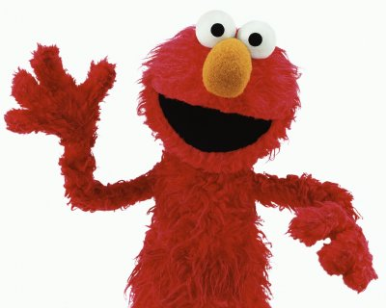
Affable
from ad- "to" + fari "to speak"
Elmo is one of the most affable characters on children’s television.
(Adjective) courteous and pleasant, sociable, easy to speak to
Synonyms: genial, amicable, agreeable, cordial

Slide 2
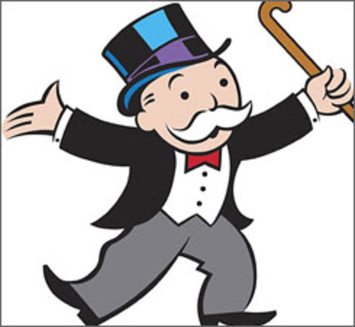
Aggrandize
L. ad "to" + grandire "to make great,"
(verb) to increase in greatness, power, or wealth; to build up or intensify; to make appear greater
Synonyms: augment, amplify, enhance, exalt

Slide 3
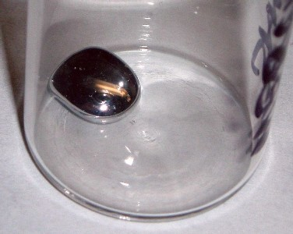
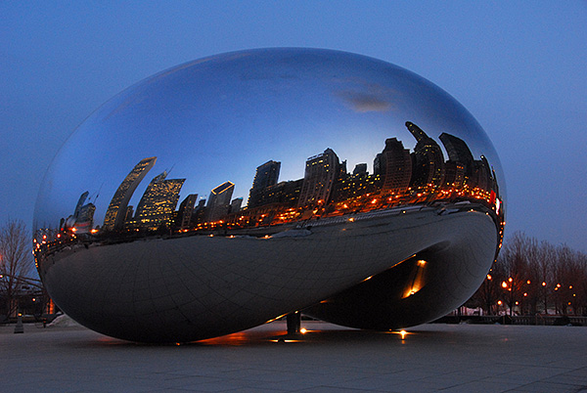
Amorphous
a- "without" + morphe "form"
Mercury is an amorphous liquid metal that does not have a definite shape.
Some people have a hard time understanding the amorphous shape of this sculpture and prefer to call it the Chicago bean.
(adjective) shapeless, without definite form; of no particular type or character; without organization, unity, or cohesion
Synonyms: formless, unstructured, nebulous, inchoate

Slide 4
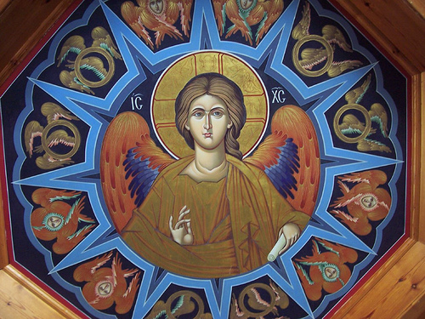
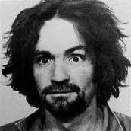
Aura
Gk. aura "breath, breeze,"
Charles Manson has an aura of insanity
Byzantine art often gives angels an aura, as if they radiated light.
(Noun) that which surrounds (as an atmosphere); a distinctive air or personal quality
Synonyms: ambience, atmosphere

Slide 5
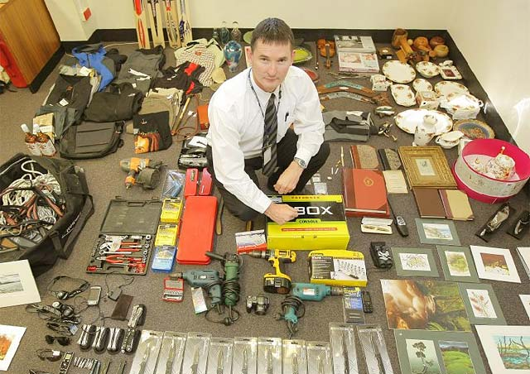
Contraband
L. contra "against" + L. bannum, "a command"
Officer McKenzie poses with numerous items of contraband at an airport security port.
(noun) illegal traffic, smuggled goods (adjective) illegal, prohibited
Synonyms: illicit, bootleg, unlawful
Antonyms: legal, lawful, licit

Slide 6
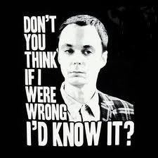
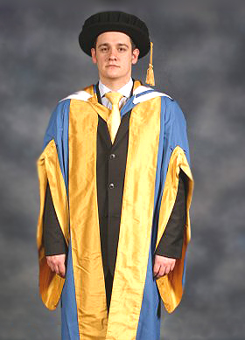
Erudite
ex- "out"+ rudis "unskilled, rough, unlearned"
Erudite people like Dr. Schmidt get to wear gowns like this one.
Sometimes being erudite means you know too much for your own good.
(adjective) scholarly, learned, bookish, pedantic
Synonyms: profoundly educated, well-read
Antonyms: ignorant, uneducated, illiterate

Slide 7
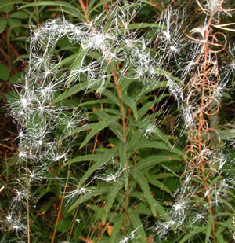
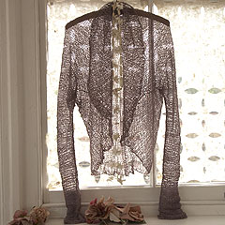
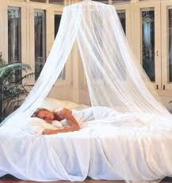
Gossamer
gos "goose" + sumer "summer" (cf. Swed. sommertrad "summer thread)
The gossamer cobweb
caught the seeds as they flew by.
(adjective) thin, light, delicate, insubstantial (noun) a very thin, light cloth
Synonyms: filmy, diaphanous, sheer, airy, feathery, gauzy
Antonyms: thick, dense, solid, massive

Slide 8
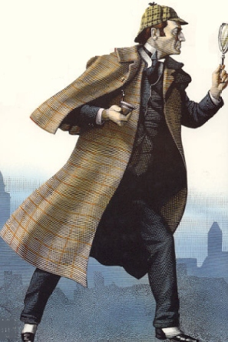
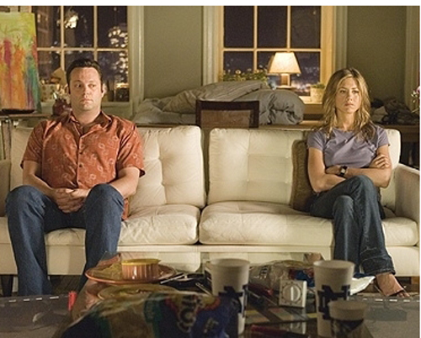
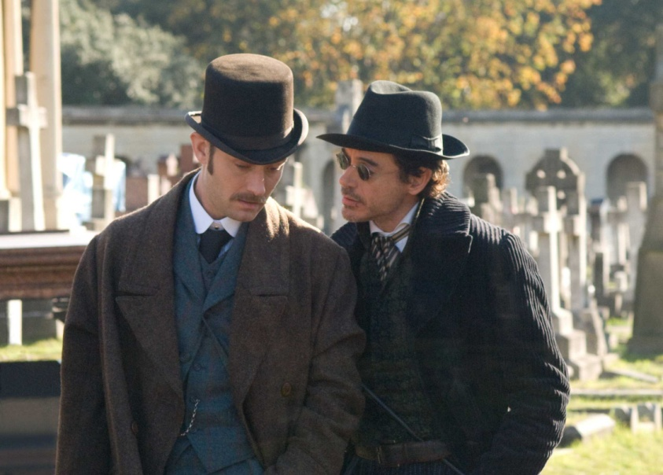
Infer
in- "in"+ ferre "carry, bear,"
Because of the size of the footprints, Sherlock Holmes could only infer that the culprit was a man.
Are you inferring that I made you angry on purpose?
(verb) to find out by reasoning; to arrive at a conclusion on the basis of thought; to hint, suggest, imply
Synonyms: gather, deduce, presume, guess, speculate

Slide 9
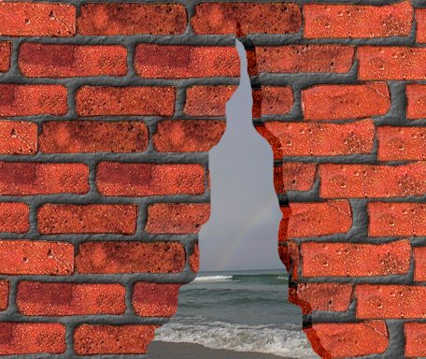
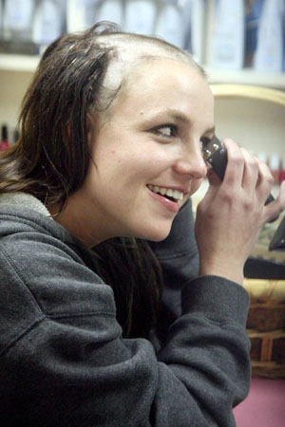
Inscrutable
in- "not, opposite of" + scrutari "examine"
Britney’s actions were completely inscrutable.
The brick wall was not entirely inscrutable; they found a crack near the bottom that they could see through.
(adjective) incapable of being understood; impossible to see through physically
Synonyms: impenetrable, incomprehensible, enigmatic
Antonyms: comprehensible, intelligible, penetrable

Slide 10
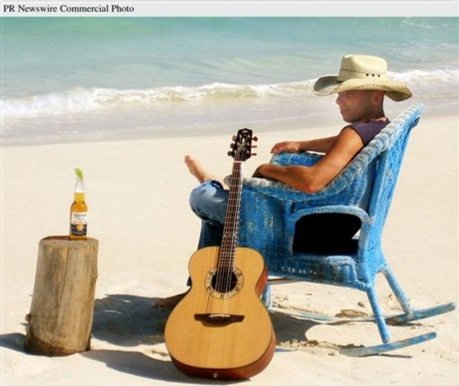
Insular
L. insula "island" (Metaphoric sense "narrow, prejudiced“)
Tom Cruise’s insular views on psychiatric medicine have upset many people.
Kenney Chesney is an insular resident, and his island lifestyle suits him just fine.
(adjective) relating to, characteristic of, or situated on an island; narrow or isolated in outlook or experience
Synonyms: narrow-minded, parochial, provincial
Antonyms: catholic, cosmopolitan, liberal

Slide 11
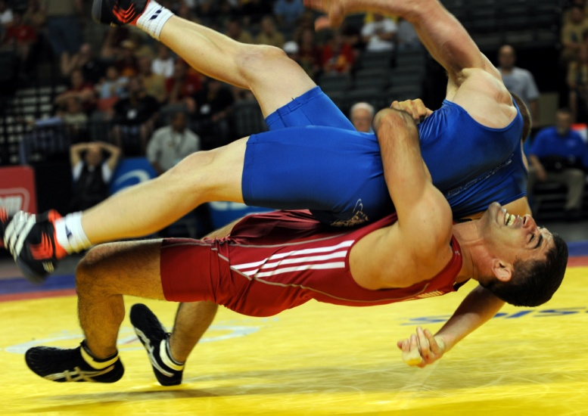
Irrevocable
in- "not, opposite of"+ (re- "back" + vocare "to call"
After their divorce, Angelina Jolie had to cover the irrevocable Billy Bob tattoo with others.
The mat official’s opinion did not matter, because the chairman’s decision was irrevocable.
(adjective) incapable of being changed or called back
Synonyms: irreversible, unrecallable, unalterable

Slide 12
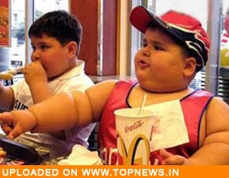
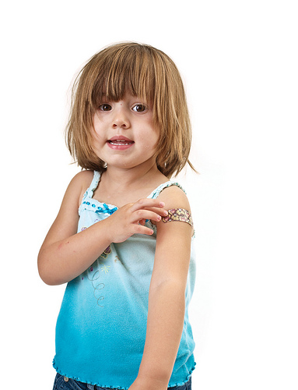
Propensity
L. pro- "forward" + pendere "hang"
Children who eat a lot of fast food have shown an alarming propensity to grow overweight, which can lead to serious diseases in later life.
Little kids have a propensity for falling down and getting hurt.
(noun) a natural inclination or predilection toward
Synonyms: natural bent, proclivity, penchant

Slide 13
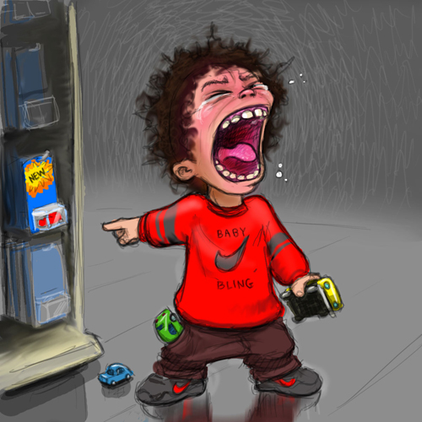
Querulous
The querulous child demanded another new toy.
(adjective) peevish, complaining, fretful
Synonyms: petulant, touchy, cranky, irritable
Antonyms: uncomplaining, stoical, serene, placid

Slide 14
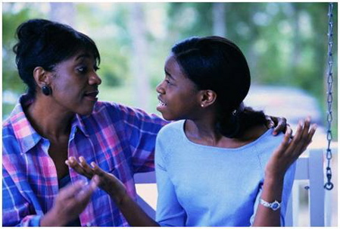
Remonstrate
She remonstrated with her mother over the use of the car on Friday night.
(verb) to argue or plead with someone against something; protest against, object to
Synonyms: reason, against, expostulate

Slide 15
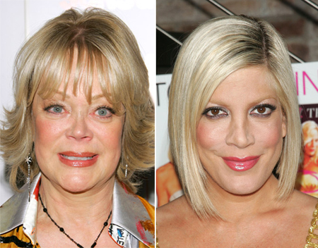
Repudiate
Ever since the death of her father, Tori publicly repudiated her mother.
(verb) to disown, reject, or deny the validity of
Synonyms: disavow, abjure, renounce
Antonyms: avow, affirm, aver, avouch

Slide 16
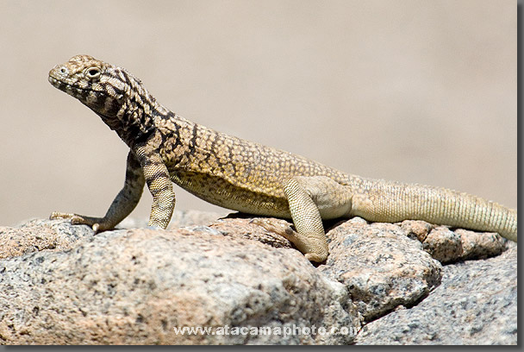
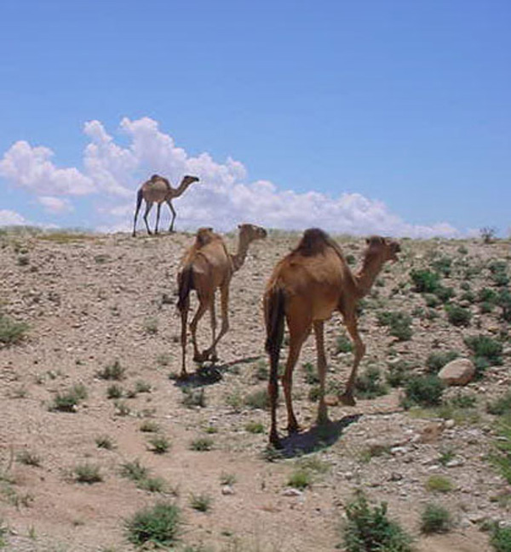
Resilient
Desert animals must be resilient to extreme heat and dryness in order to survive.
(adjective) able to return to an original shape or form; able to recover quickly
Synonyms: springy, elastic, buoyant, bouncy
Antonyms: rigid, stiff, inflexible, unyielding

Slide 17
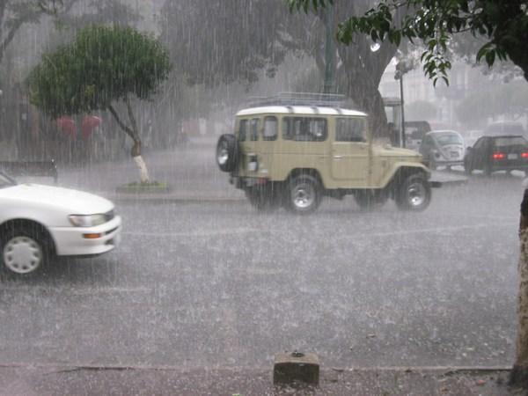
Reverberate
The sound of the rain hitting the windows reverberated throughout the car.
(verb) to re-echo, resound; to reflect or be reflected repeatedly
Synonyms: rumble, thunder, boom, echo

Slide 18
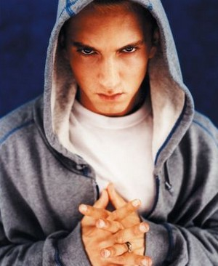
Scurrilous
Eminem’s scurrilous lyrics usually attack his mother or his ex-wife, Kim.
(adjective) coarsely abusive, vulgar or low (especially in language) foul-mouthed
Synonyms: obscene, filthy, abusive, vituperative
Antonyms: decorous, seemly, tasteful, dignified

Slide 19
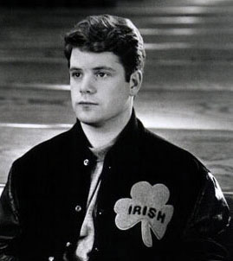
Sedulous
His sedulous work ethic got him a spot on the football team.
(adjective) persistent, showing industry and determination
Synonyms: assiduous, tireless, indefatigable
Antonyms: lackadaisical, listless, indolent, otiose

Slide 20
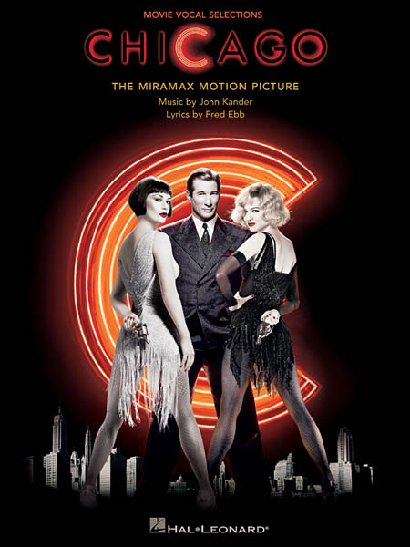
Sleazy
Roxie is a chorus girl who has murdered her lover but manages to get acquitted with the help of sleazy lawyer Billy Flynn.
Courtney Love’s choice in clothing often looks rather sleazy.
(Adjective) thin or flimsy in texture; cheap; shoddy or inferior in quality or character; ethically low, mean or disreputable
Synonyms: inferior, cheesy, tawdry, tatty
Antonyms: superior, first-rate, quality, sturdy

